Slide 1

Netflix's Movie and Series Recommendations
Nicolas De Greef
Iman Ben Omar El Khattabi
Maria-Mihaela Fetcu
Glory Singh

Slide 2

WHAT IS AI?

Slide 3
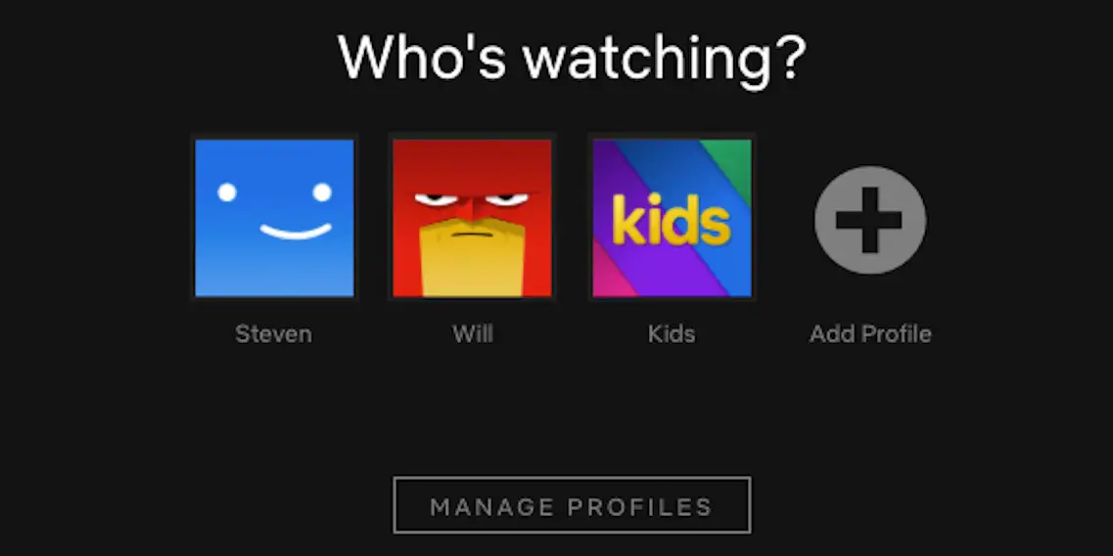

DIFFERENT NETFLIX USERS
Cold start for new users
Dynamic user preferences
Multiple users on a single profile

Slide 4
COLLABORATIVE FILTERING
Netflix's recommendation system primarily relied on collaborative filtering. This technique involves analyzing user behavior and preferences to make recommendations. Netflix collects data on what users watch, how long they watch it, when they watch, and even how they rate different titles. It then uses this data to find patterns and similarities among users with similar tastes.
CONTENT-BASED FILTERING
In addition to collaborative filtering, Netflix also used content-based filtering. This involves analyzing the characteristics of movies and TV shows (such as genre, actors, directors, and plot keywords) and recommending content that is similar in nature to what a user has previously enjoyed.

Slide 5
MACHINE LEARNING ALGORITHMS
Netflix employs various machine learning algorithms to process and analyze the vast amount of data it collects from its users. These algorithms are constantly learning and adapting to changes in user behavior and preferences.
PERSONALIZATION
Netflix's recommendation system aims to provide a highly personalized experience for each user. The more you use Netflix, the better it becomes at understanding your preferences and suggesting content that you are likely to enjoy.

Slide 6
A/B TESTING
Netflix uses A/B testing extensively to evaluate the effectiveness of different recommendation algorithms and user interface changes. They often run multiple experiments to determine which recommendations drive the most engagement and user satisfaction.
DEEP LEARNING
Netflix has also explored the use of deep learning techniques, including neural networks, to enhance its recommendation system. These methods can capture more intricate patterns and relationships in user data.

Slide 7

What is the primary technique Netflix uses for recommendations?
a) Artificial Intelligence
b) Collaborative Filtering
c) Social Media Data

Slide 8
Which type of data does Netflix NOT consider when making recommendations?
a) User Ratings
b) Watch History
c) GPS Location?

Slide 9


